Slide 1



Presented By:
Dr. Nicole Colón Carrión
Dr Sofía Macchiavelli Girón
Invited Speaker:
Dr. Marcos J. Ramos Benitez
PERSONAL STATEMENT; RESUME AND CV
October 2023

Slide 2

Table Of Content
Content List
01.
03.
05.
Personal Statement
Examples
Resume
02.
04.
06.
Structure of a PS
Curriculum vitae
CV vs Resume

Slide 3


Personal Statement
Definition
a written description of one's achievements, interests, etc., included as part of an application for a job or to an educational program. (Source: Oxford dictionary).
Introduction
Format
Format may vary based on application requirements/schools, but usually:
2-3 page statement
double-spaced
1-inch margins
Times New Roman font, 12-pt

Slide 4
Personal Statement
01
Who can ask you for it?
Introduction
Summer internship applications
Graduate school applications
Medical school applications
Research internships
Grants, Scholarships, or Fellowships
Awards

Slide 5
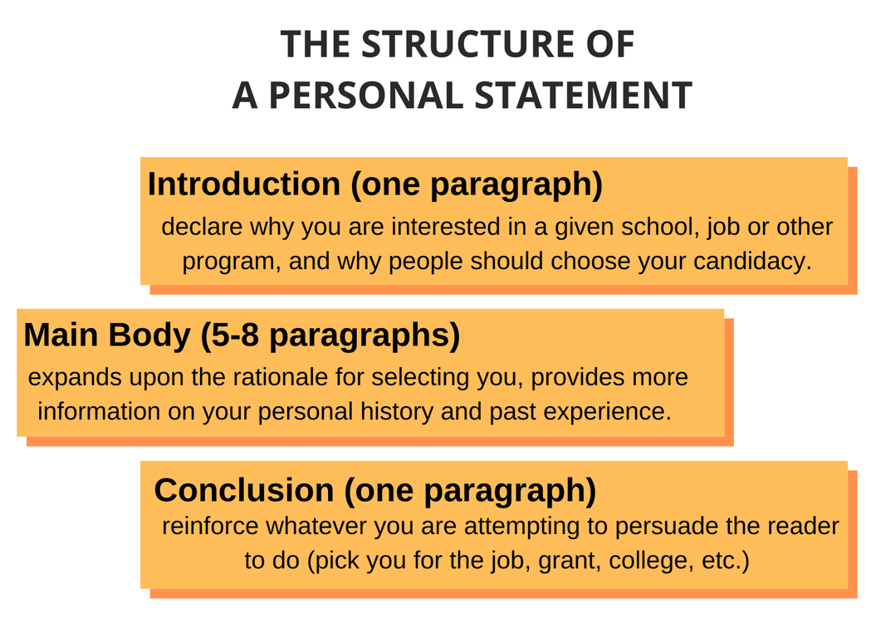
Source: https://www.essaytigers.com/how-write-personal-statement

Slide 6
Personal Statement
Questions to ask before you write
01
What's special, unique, distinctive, and/or impressive about you or your life story?
What details might help the committee better understand you or help set you apart from other applicants?
When did you become interested in this field and what have you learned about it?
How have you learned about this field—through classes, readings, seminars, work or other experiences, or conversations with people already in the field?
What are your career goals?
Are there any gaps or discrepancies in your academic record that you should explain?
Have you had to overcome any unusual obstacles or hardships (for example, economic, familial, or physical) in your life?
What personal characteristics do you possess that would improve your prospects for success in the field or profession?
What skills (for example, leadership, communicative, analytical) do you possess?
Why might you be a stronger candidate for graduate school—and more successful and effective in the profession or field than other applicants?
What are the most compelling reasons you can give for the admissions committee to be interested in you?
Source: https://owl.purdue.edu/owl/job_search_writing/preparing_an_application/writing_the_personal_statement/index.html

Slide 7

Curriculum
Vitae
Definition
a written description of one's achievements, interests, etc., included as part of an application for a job or to an educational program. (Source: Oxford dictionary).
Introduction
Format
Format may vary based on application requirements/schools, but usually:
No page limit
double-spaced
1-inch margins
Times New Roman font, 12-pt

Slide 8
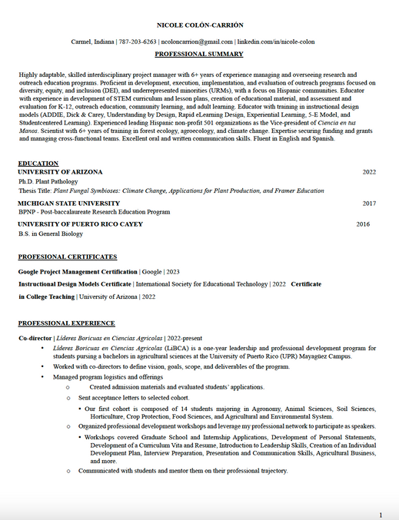
Curriculum Vitae Sections
Information
01
Name, phone, email, linkedIN
Professional Summary
02
Your experience summarized in 3-5 sentences
Education & Certificates
03
University, Degree/Certificate, Year
Professional Experience
04
Title, Company, Years
Bullet points indicating roles
USE SMART Goals to do this section

Slide 9
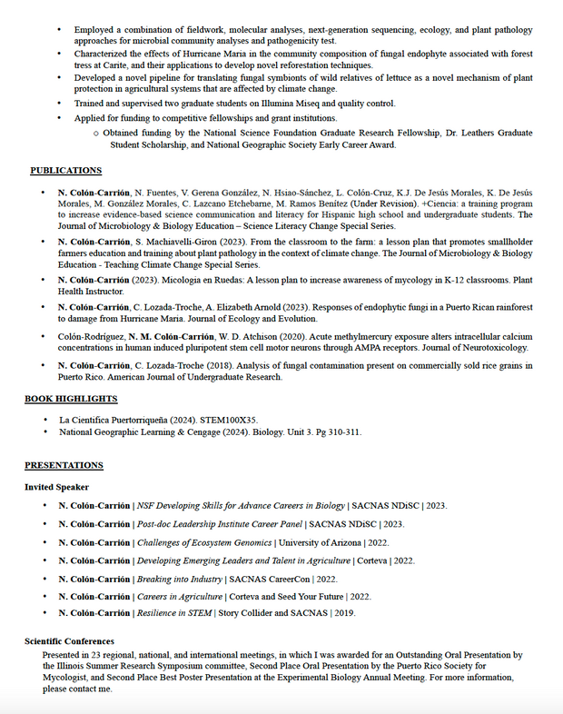
Curriculum Vitae Sections
Publications
05
Authors, Year, Title, Journal
Follow APA
Presentations
06
Title, date, place

Slide 10
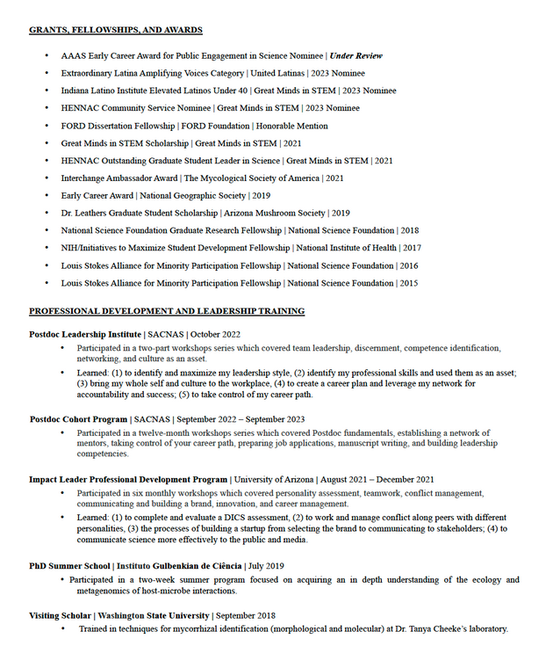
Curriculum Vitae Sections
Awards & Grants
07
Award/Grant, who gave it, year
Professional Development
08
Program, place, year
Description of learning and skills
Other sections that should be included:
Teaching Experience
Associations and memberships
Leadership roles
Volunteering

Slide 11

Source: StandOut CV

Slide 12

Definition
Resume
a document created and used by a person to present their background, skills, and accomplishments. (Source: Oxford dictionary).
Introduction
Three types of resume
Reverse-chronological
Functional
Combination
Format
1-2 pages
one-inch margins
elegant font, 11–12pt font size
single line spacing

Slide 13
Resume Sections
Information
01
Name, phone, email, linkedIN
Professional Summary
02
Your experience summarized in 3-5 sentences
Education & Certificates
03
University, Degree/Certificate, Year
Professional Experience
04
Title, Company, Years
Bullet points indicating roles
USE SMART Goals to do this section
Other sections that should be included: Skills

Slide 14

Source: Jeff Su

Slide 15
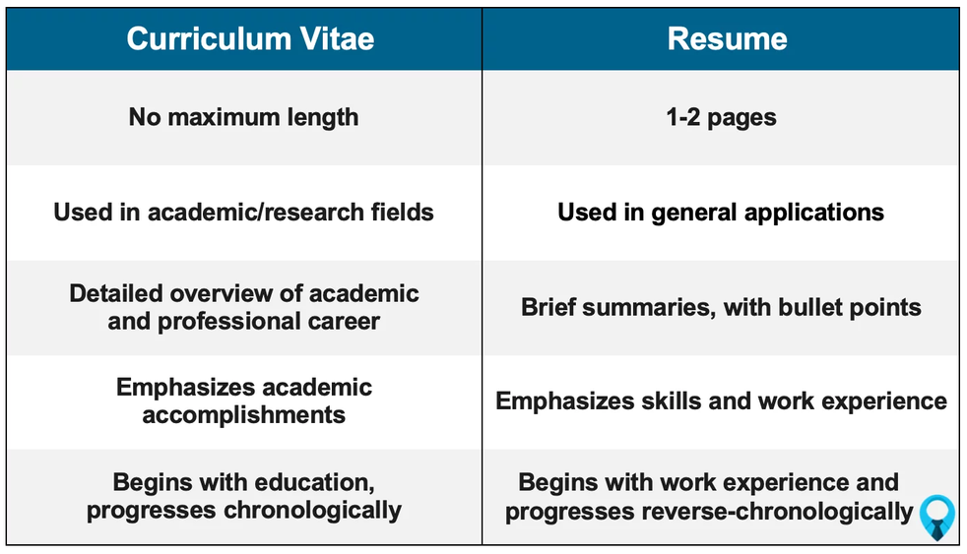
Source: https://www.findmyprofession.com/career-advice/cv-vs-resume-difference-samples/

Slide 16

Source: MedSchool Insiders

Slide 17
Presented By:
Dr. Nicole Colón Carrión
Dr Sofía Macchiavelli Girón
Invited Speaker:
Dr. Marcos J. Ramos Benitez
PERSONAL STATEMENT; RESUME AND CV
October 2023

